Slide 1

Module 4
Evaluating Model Performance
Notes:
Guidelines
Use section headers to chunk content in your presentation.
Use the same style of section header throughout your presentation.
Keep your title to no more than 2 lines.

Slide 2

Model Performance Evaluation in Propensity Modeling
Notes:
Guidelines
Use a title slide at the beginning of your presentation. There are 9 variations of title slides to choose from.
If you will have a series of slideshows, we recommend using the same style of title slide for each presentation.
Keep your title to no more than 2 lines.
Do not change the font style or font size of the title or subtitle.

Slide 3
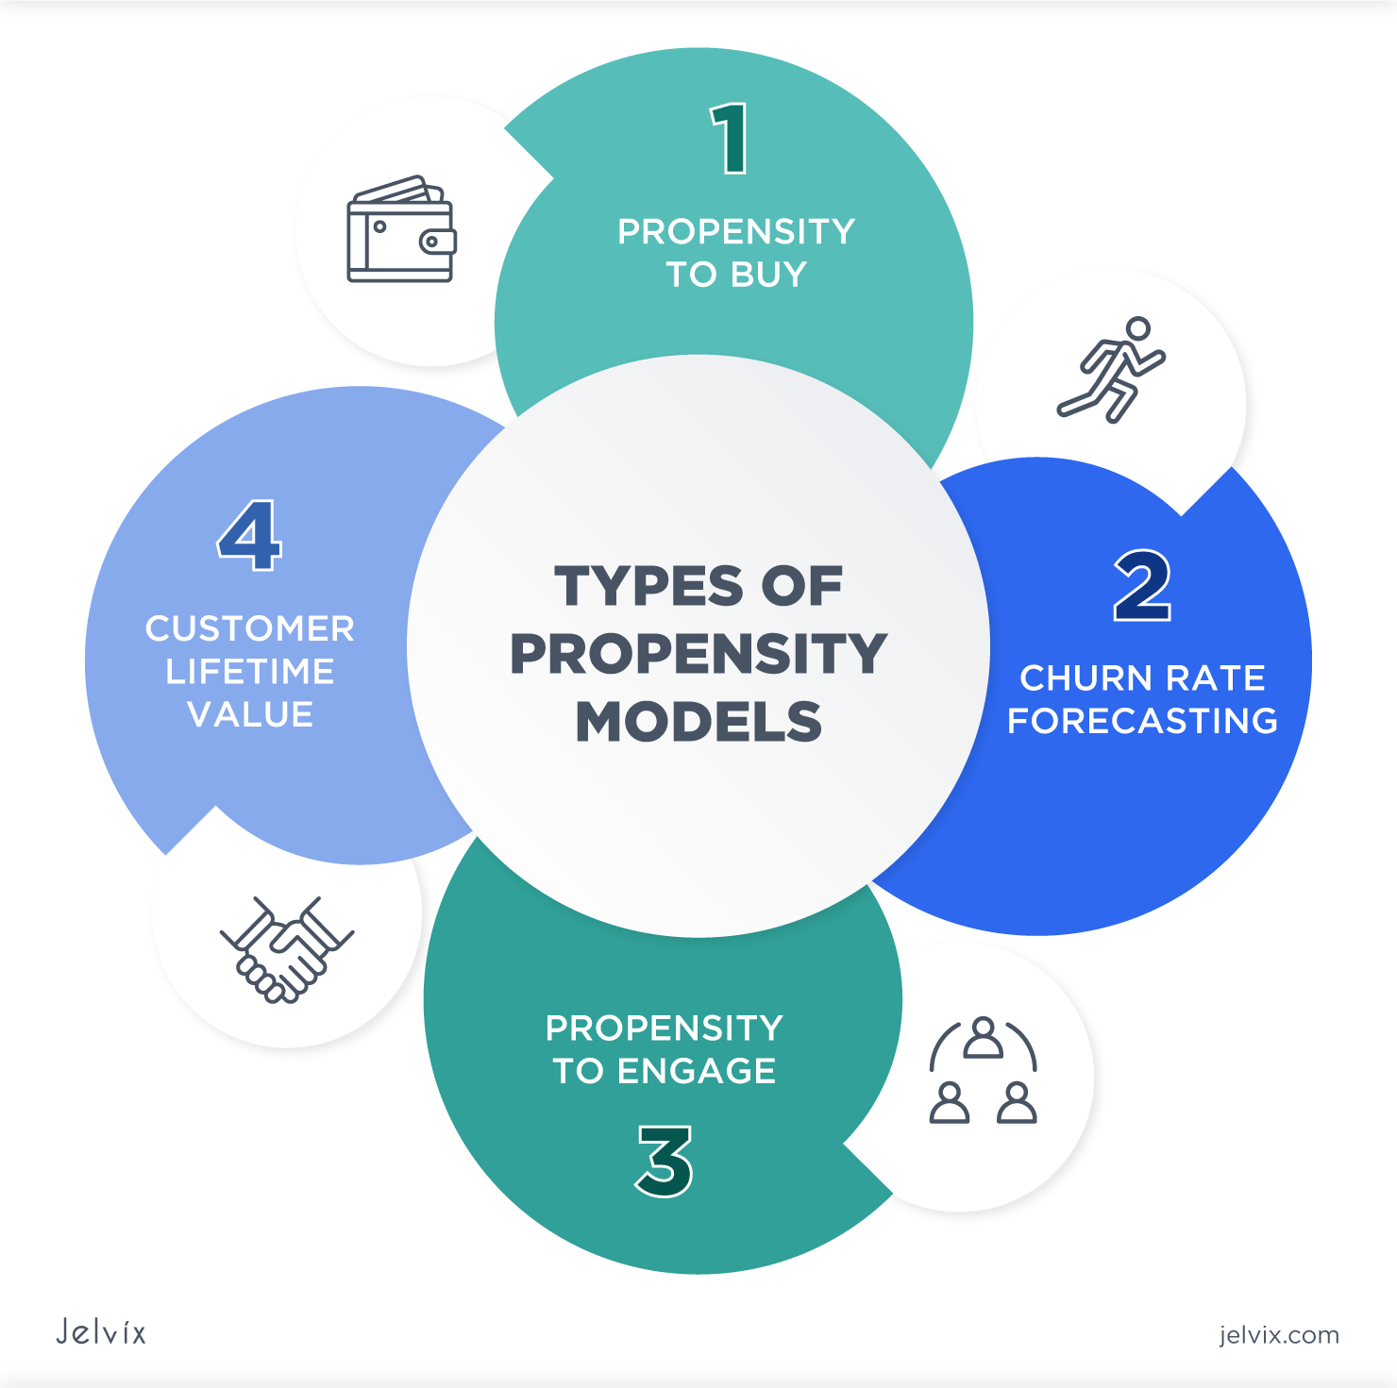
Propensity Modeling
Technique used to predict the chances of certain events happening
Used extensively to predict customer behavior
Fraud modeling
Customer churn
Marketing

Slide 4
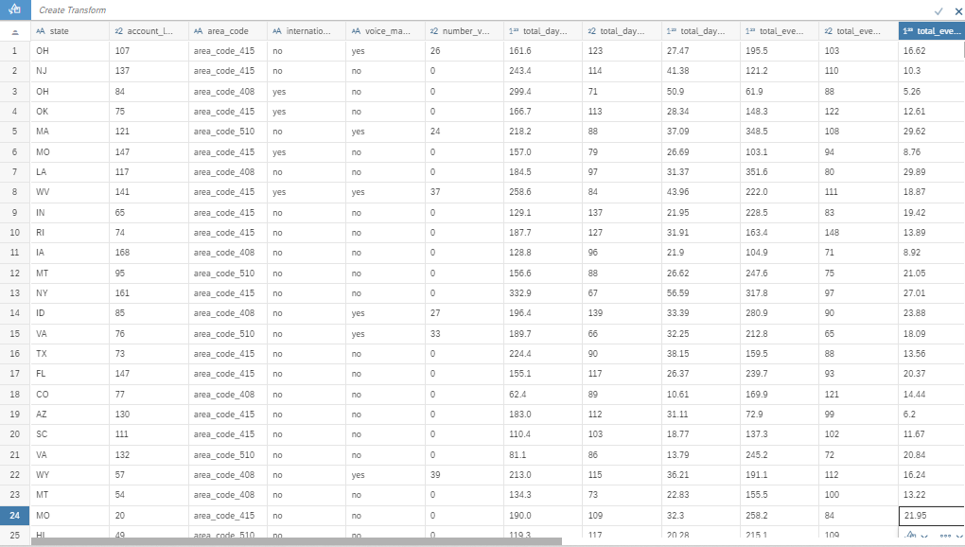
Propensity Modeling (Churn)
Not interested in classifying observations into one group or another
We just would like to “skim the cream” from the top.

Slide 5
Propensity Modeling (Likely Donors)
Not interested in classifying observations into one group or another
We just would like to “skim the cream” from the top.

Slide 6
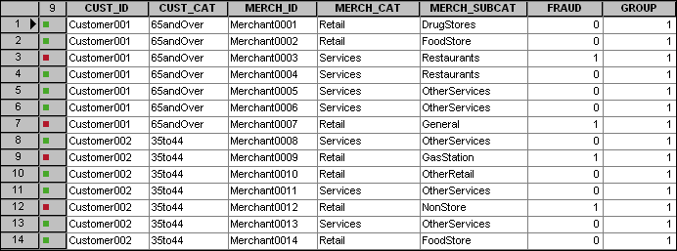


Propensity Modeling (Fraud)
Not interested in classifying observations into one group or another
We just would like to “skim the cream” from the top.
Prob
0.178
0.156
0.122
0.105
0.074
0.051
0.035
0.032
0.032
0.027
0.021
0.017
0.015
0.012

Slide 7
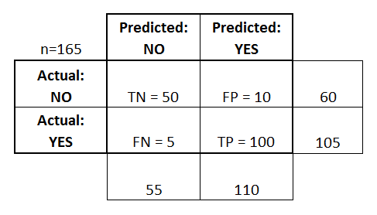
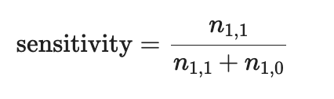




Sensitivity (True Positive Rate)
The fraction of all 1’s that are classified (predicted) as 1’s.
$$n_{0,0}$$
$$n_{0,1}$$
$$n_{1,0}$$
$$n_{1,1}$$

Slide 8

1-Specificity (False Positive Rate)
The fraction of all 0’s that are classified (predicted) as 1’s.
$$n_{0,0}$$
$$n_{0,1}$$
$$n_{1,0}$$
$$n_{1,1}$$

Slide 9
True Positive Rate vs False Positive Rate
Prob
0.178
0.156
0.122
0.105
0.074
0.051
0.035
0.032
0.032
0.027
0.021
0.017
0.015
0.012
Non-Fraud
Fraud
Non-Fraud
Threshold = 0.10
Fraud

Slide 10
True Positive Rate vs False Positive Rate
Prob
0.178
0.156
0.122
0.105
0.074
0.051
0.035
0.032
0.032
0.027
0.021
0.017
0.015
0.012
Non-Fraud
Fraud
Non-Fraud
Fraud

Slide 11
True Positive Rate vs False Positive Rate
Prob
0.178
0.156
0.122
0.105
0.074
0.051
0.035
0.032
0.032
0.027
0.021
0.017
0.015
0.012
Non-Fraud
Fraud
Non-Fraud
Fraud

Slide 12
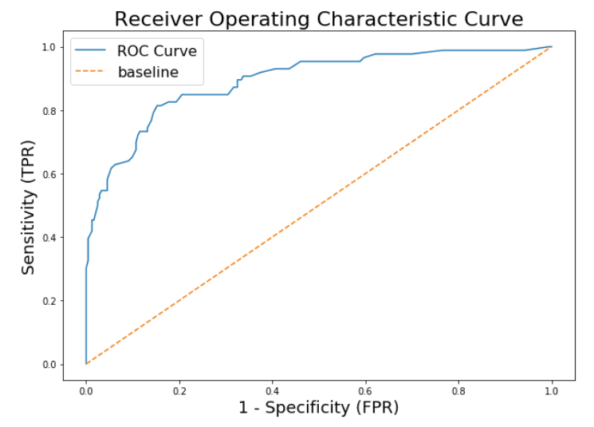
ROC Curve
Receiver Operating Characteristic (ROC) curves plot the true positive rate (sensitivity) vs the false positive rate (1 – specificity) for many possible cutoff values.

Slide 13
Area Under the Curve (AUC)
Measures the ability of a binary classifier to distinguish between classes

Slide 14
Optimal Threshold
Select the cutoff with the highest TPR and lowest FPR
Youden’s J Statistic

Slide 15
Optimal Threshold
Select the cutoff with the highest TPR at a given FPR

Slide 16
Optimal Threshold
Select the cutoff with a given TPR and the lowest FPR

Slide 17
Python
Notes:
Guidelines
Use a title slide at the beginning of your presentation. There are 9 variations of title slides to choose from.
If you will have a series of slideshows, we recommend using the same style of title slide for each presentation.
Keep your title to no more than 2 lines.
Do not change the font style or font size of the title or subtitle.

Slide 18
Propensity to Respond to Offer
“Skim the cream” of potential offer responders
Income | Kidhome | Teenhome | MntTotal | MntRegularProds | AcceptedCmpOverall | Accepted | Prob
69674 | 0 | 2 | 821 | 797 | 0 | 0 | 0.999996174
83151 | 0 | 0 | 729 | 711 | 0 | 1 | 0.980104525
26518 | 1 | 1 | 55 | 53 | 0 | 1 | 0.973468011
41850 | 1 | 1 | 92 | 88 | 0 | 1 | 0.97217383
29187 | 1 | 0 | 32 | 30 | 0 | 1 | 0.966767403
89891 | 0 | 0 | 653 | 470 | 1 | 1 | 0.959227217
68352 | 0 | 1 | 838 | 805 | 0 | 0 | 0.951466375
38097 | 1 | 1 | 115 | 46 | 1 | 1 | 0.951371695
33378 | 1 | 1 | 89 | 79 | 0 | 1 | 0.950251624
66334 | 0 | 1 | 1138 | 1115 | 0 | 1 | 0.949141087
18589 | 0 | 0 | 62 | 49 | 0 | 0 | 0.941998084
56253 | 0 | 1 | 592 | 587 | 0 | 1 | 0.941647232
42670 | 0 | 0 | 226 | 211 | 0 | 1 | 0.929693954
56046 | 0 | 0 | 641 | 590 | 1 | 1 | 0.92148826
80124 | 0 | 0 | 1254 | 1013 | 1 | 1 | 0.91995912
55951 | 0 | 1 | 1334 | 1294 | 2 | 1 | 0.91995912
26850 | 1 | 1 | 54 | 45 | 0 | 1 | 0.919075708
61794 | 0 | 1 | 600 | 589 | 0 | 1 | 0.905926951
35860 | 1 | 1 | 29 | 9 | 1 | 1 | 0.894680439
21918 | 1 | 0 | 30 | 27 | 0 | 0 | 0.892837798

Slide 19
Propensity to Respond to Offer
“Skim the cream” of potential offer responders
Income | Kidhome | Teenhome | MntTotal | MntRegularProds | AcceptedCmpOverall | Accepted | Prob
69674 | 0 | 2 | 821 | 797 | 0 | 0 | 0.999996174
83151 | 0 | 0 | 729 | 711 | 0 | 1 | 0.980104525
26518 | 1 | 1 | 55 | 53 | 0 | 0 | 0.973468011
41850 | 1 | 1 | 92 | 88 | 0 | 0 | 0.97217383
29187 | 1 | 0 | 32 | 30 | 0 | 0 | 0.966767403
89891 | 0 | 0 | 653 | 470 | 1 | 0 | 0.959227217
68352 | 0 | 1 | 838 | 805 | 0 | 0 | 0.951466375
38097 | 1 | 1 | 115 | 46 | 1 | 1 | 0.951371695
33378 | 1 | 1 | 89 | 79 | 0 | 0 | 0.950251624
66334 | 0 | 1 | 1138 | 1115 | 0 | 0 | 0.949141087
18589 | 0 | 0 | 62 | 49 | 0 | 0 | 0.941998084
56253 | 0 | 1 | 592 | 587 | 0 | 0 | 0.941647232
42670 | 0 | 0 | 226 | 211 | 0 | 0 | 0.929693954
56046 | 0 | 0 | 641 | 590 | 1 | 0 | 0.92148826
80124 | 0 | 0 | 1254 | 1013 | 1 | 0 | 0.91995912
55951 | 0 | 1 | 1334 | 1294 | 2 | 0 | 0.91995912
26850 | 1 | 1 | 54 | 45 | 0 | 1 | 0.919075708
61794 | 0 | 1 | 600 | 589 | 0 | 0 | 0.905926951
35860 | 1 | 1 | 29 | 9 | 1 | 1 | 0.894680439
21918 | 1 | 0 | 30 | 27 | 0 | 0 | 0.892837798

Slide 20
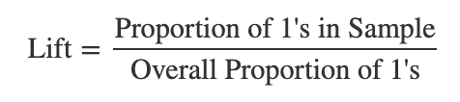
Propensity to Respond to Offer
“Skim the cream” of potential offer responders
Income | Kidhome | Teenhome | MntTotal | MntRegularProds | AcceptedCmpOverall | Accepted | Prob
69674 | 0 | 2 | 821 | 797 | 0 | 0 | 0.999996174
83151 | 0 | 0 | 729 | 711 | 0 | 1 | 0.980104525
26518 | 1 | 1 | 55 | 53 | 0 | 0 | 0.973468011
41850 | 1 | 1 | 92 | 88 | 0 | 0 | 0.97217383
29187 | 1 | 0 | 32 | 30 | 0 | 0 | 0.966767403
89891 | 0 | 0 | 653 | 470 | 1 | 0 | 0.959227217
68352 | 0 | 1 | 838 | 805 | 0 | 0 | 0.951466375
38097 | 1 | 1 | 115 | 46 | 1 | 1 | 0.951371695
33378 | 1 | 1 | 89 | 79 | 0 | 0 | 0.950251624
66334 | 0 | 1 | 1138 | 1115 | 0 | 0 | 0.949141087
18589 | 0 | 0 | 62 | 49 | 0 | 0 | 0.941998084
56253 | 0 | 1 | 592 | 587 | 0 | 0 | 0.941647232
42670 | 0 | 0 | 226 | 211 | 0 | 0 | 0.929693954
56046 | 0 | 0 | 641 | 590 | 1 | 0 | 0.92148826
80124 | 0 | 0 | 1254 | 1013 | 1 | 0 | 0.91995912
55951 | 0 | 1 | 1334 | 1294 | 2 | 0 | 0.91995912
26850 | 1 | 1 | 54 | 45 | 0 | 1 | 0.919075708
61794 | 0 | 1 | 600 | 589 | 0 | 0 | 0.905926951
35860 | 1 | 1 | 29 | 9 | 1 | 1 | 0.894680439
21918 | 1 | 0 | 30 | 27 | 0 | 0 | 0.892837798

Slide 21
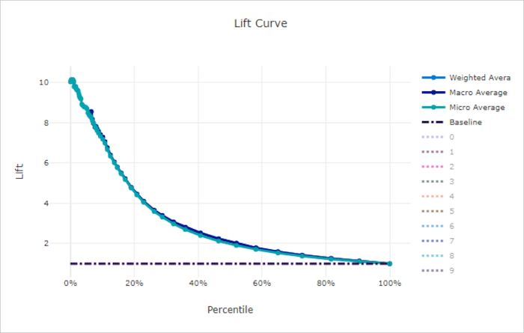
Lift Curve
The lift tells you how much better the model can identify 1’s than if you took a random sample from the data

Slide 22
Python
Notes:
Guidelines
Use a title slide at the beginning of your presentation. There are 9 variations of title slides to choose from.
If you will have a series of slideshows, we recommend using the same style of title slide for each presentation.
Keep your title to no more than 2 lines.
Do not change the font style or font size of the title or subtitle.

